Slide 1
SOFR Option Pricing
Belvedere Project
University of Chicago Project Lab

Slide 2
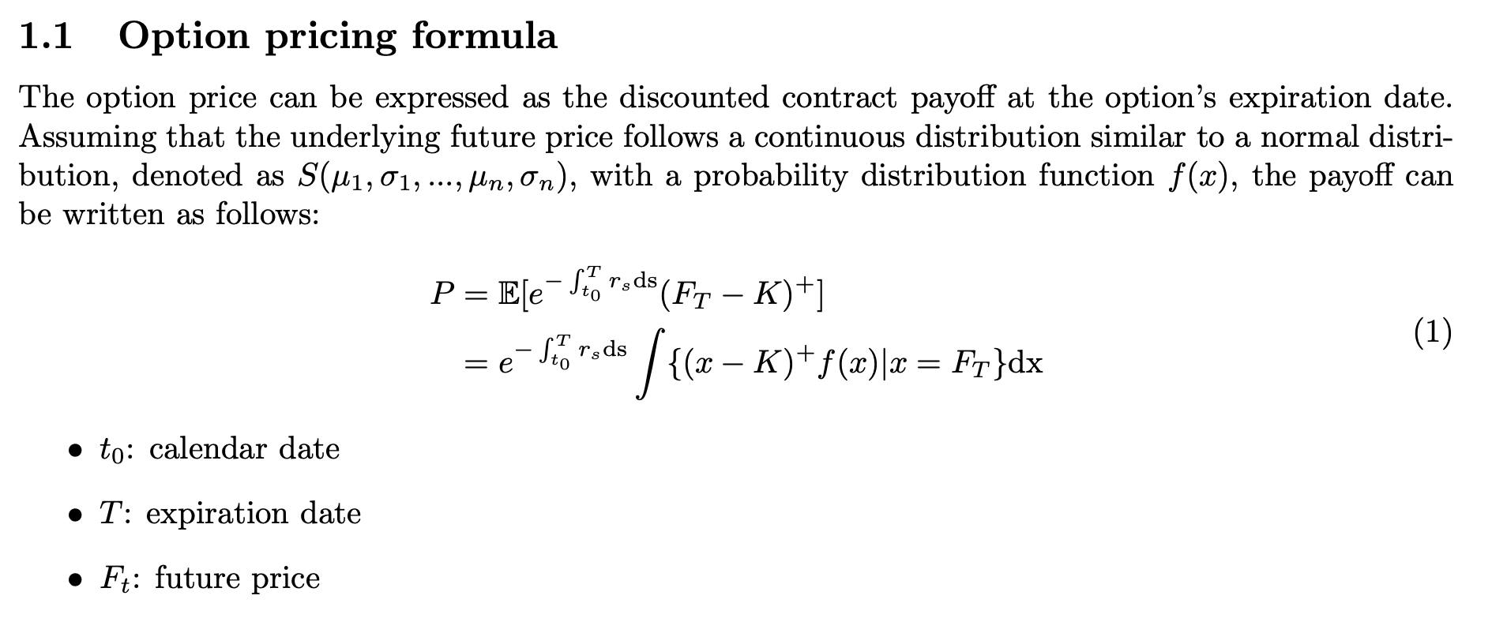

Slide 3
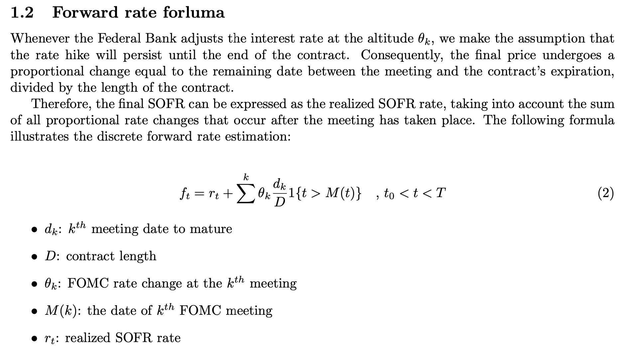

Slide 4
Multimodal Distribution

Slide 5
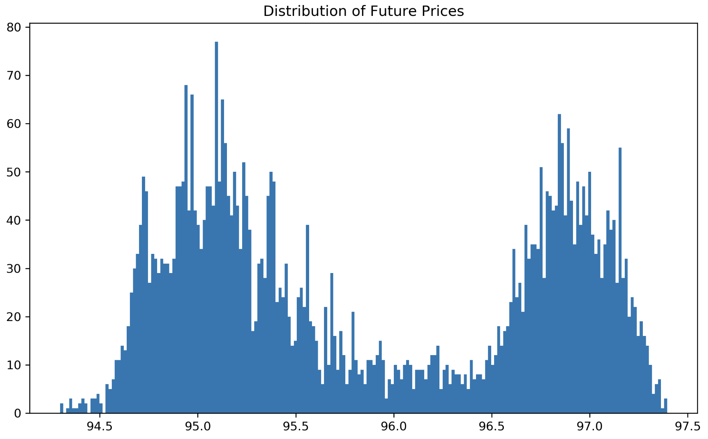
Historical Distribution of Future Price

Slide 6
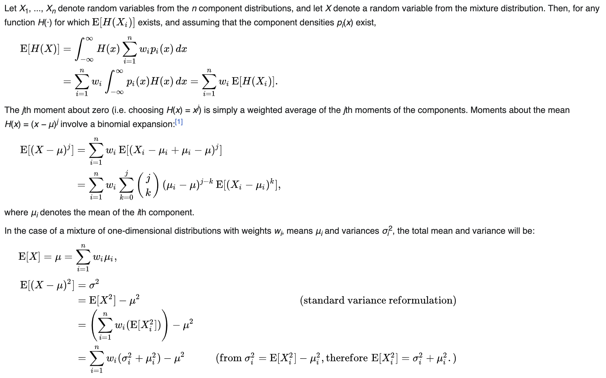
Mixture Distribution
Notes:
https://en.wikipedia.org/wiki/Mixture_distribution

Slide 7
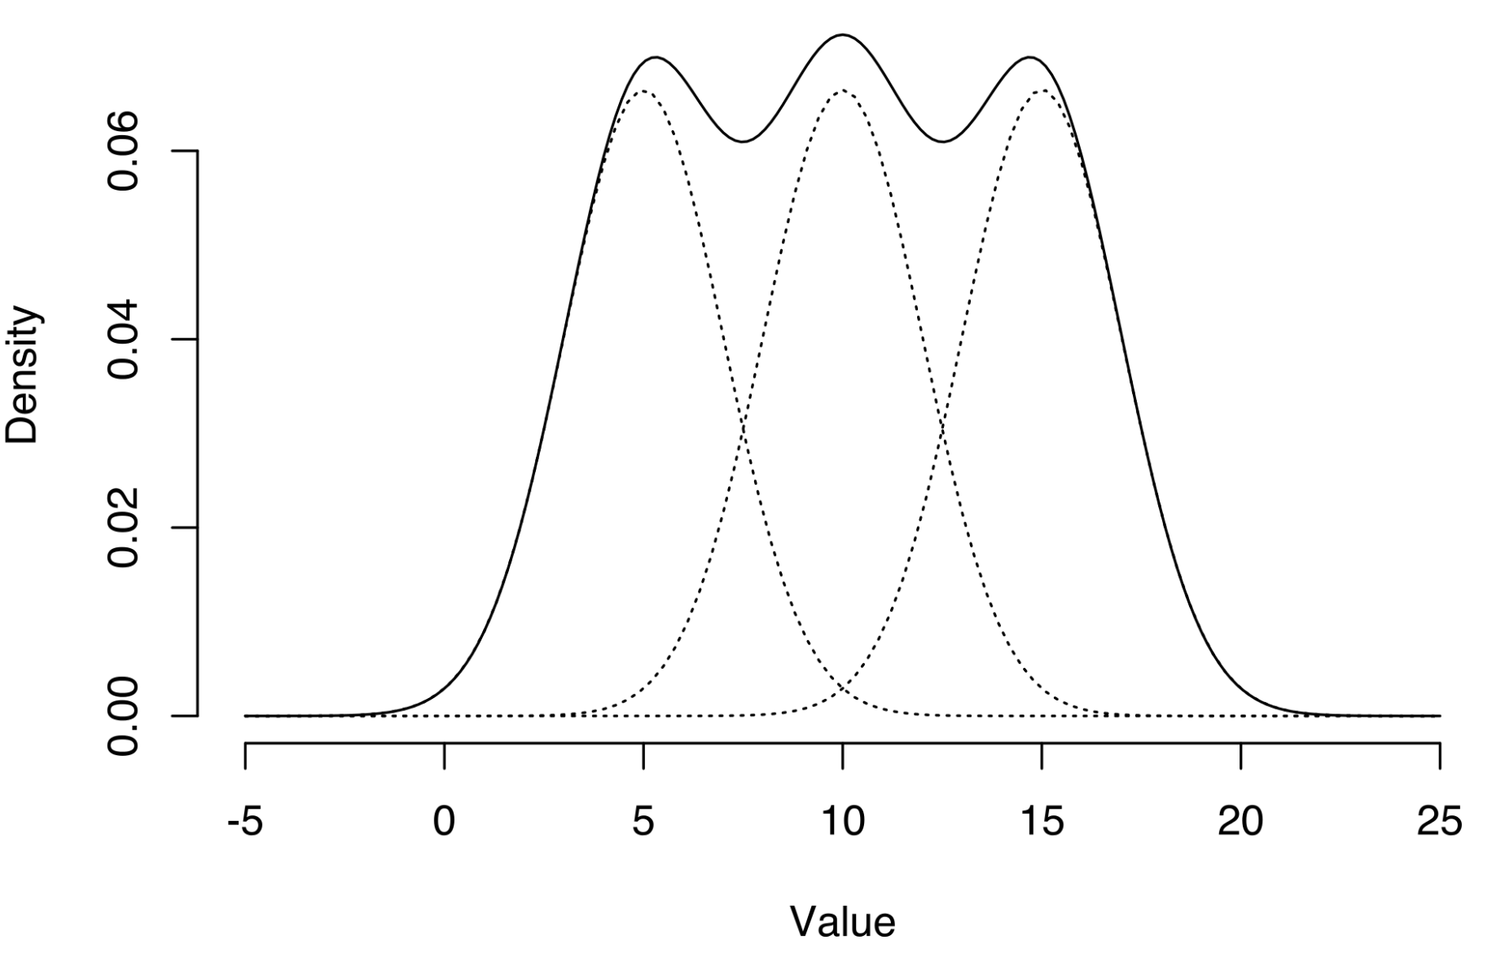
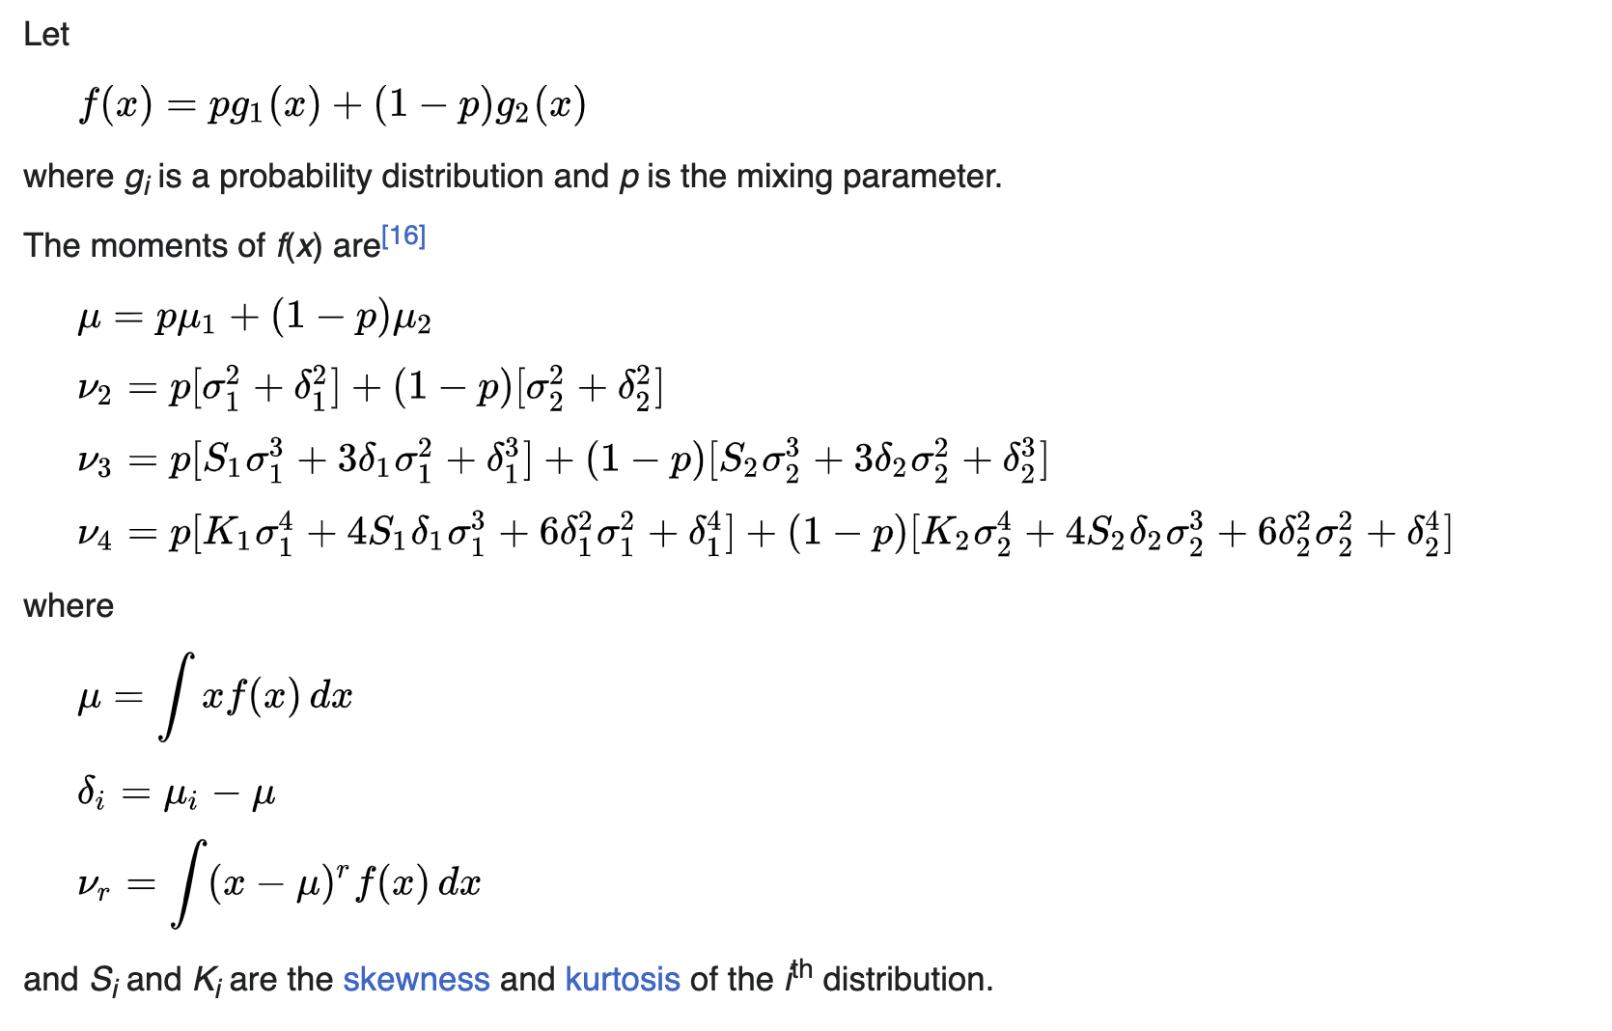
Moments of mixtures
Notes:
https://en.wikipedia.org/wiki/Multimodal_distribution#Moments_of_mixtures

Slide 8
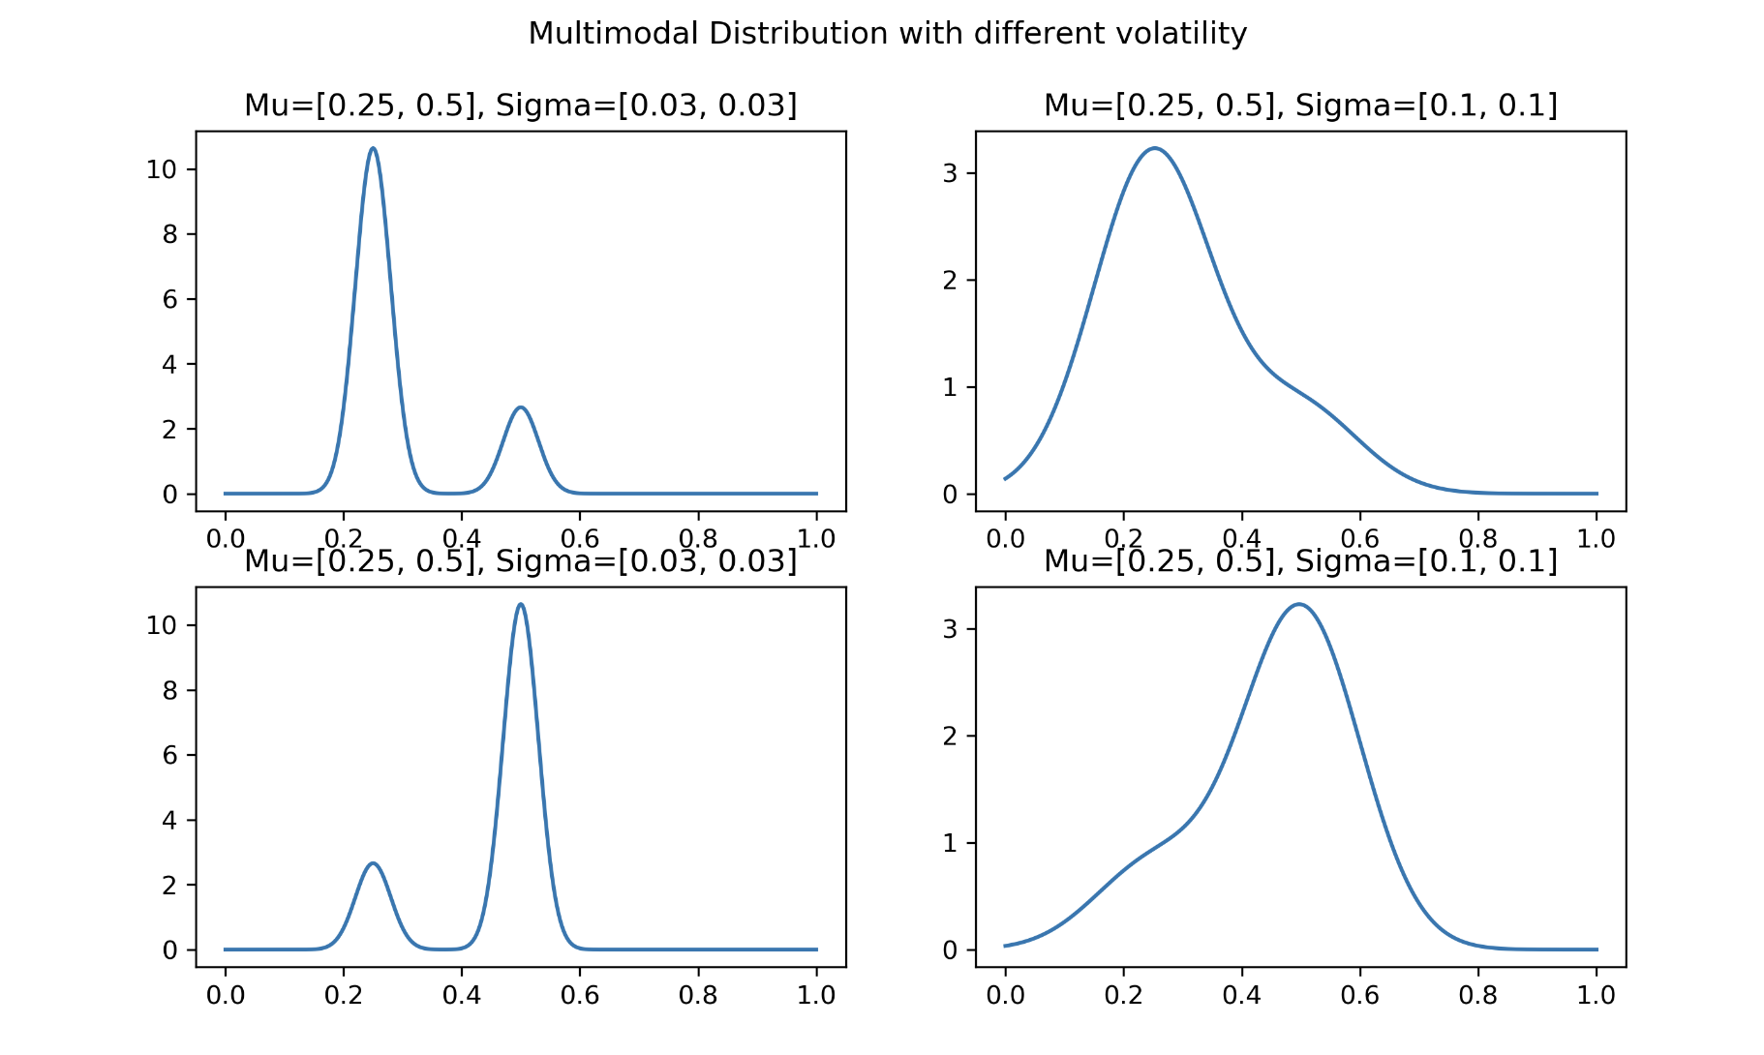

Slide 9
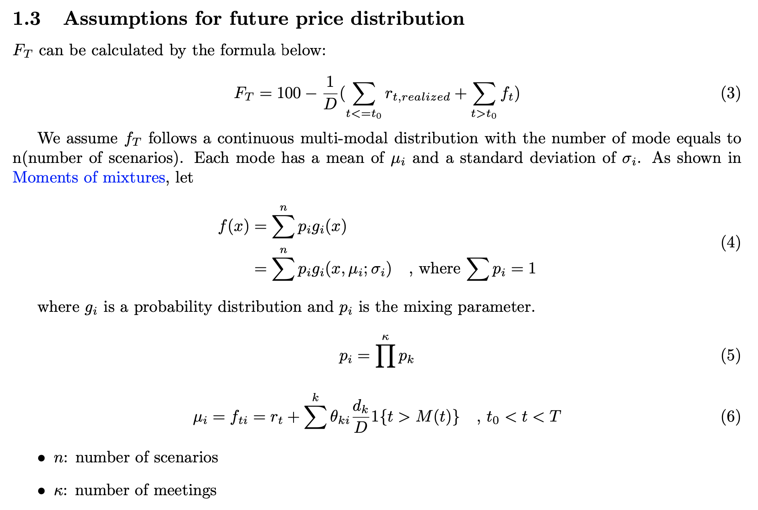

Slide 10
Base Assets Features and Volatility Estimation

Slide 11
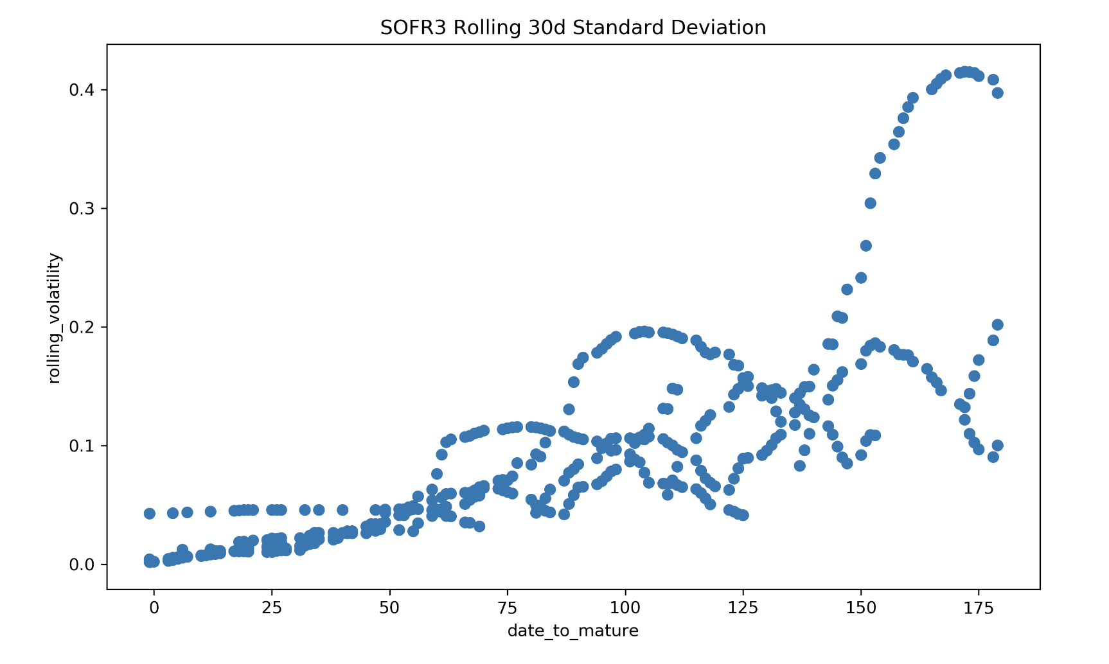
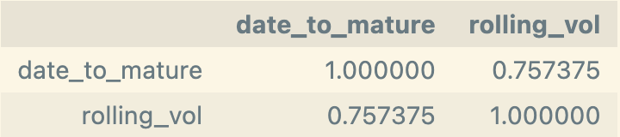
SOFR3 Rolling Std. vs. Date to Mature
Objective: Analyzing the relationship between future date to maturity and future rolling volatility for SOFR3 futures.
Rolling Window: 30d/20d
Exclusion of Abnormal Data: rolling_std = 11 and rolling_std = 7
Date-to-Maturity Filter: Exclude observations with date_to_maturity > 180 (6 months)
Key Findings: As the future approaches maturity, volatility increases and then decreases. But when considering only the three months that the future has been in the market, volatility has been decreasing

Slide 12

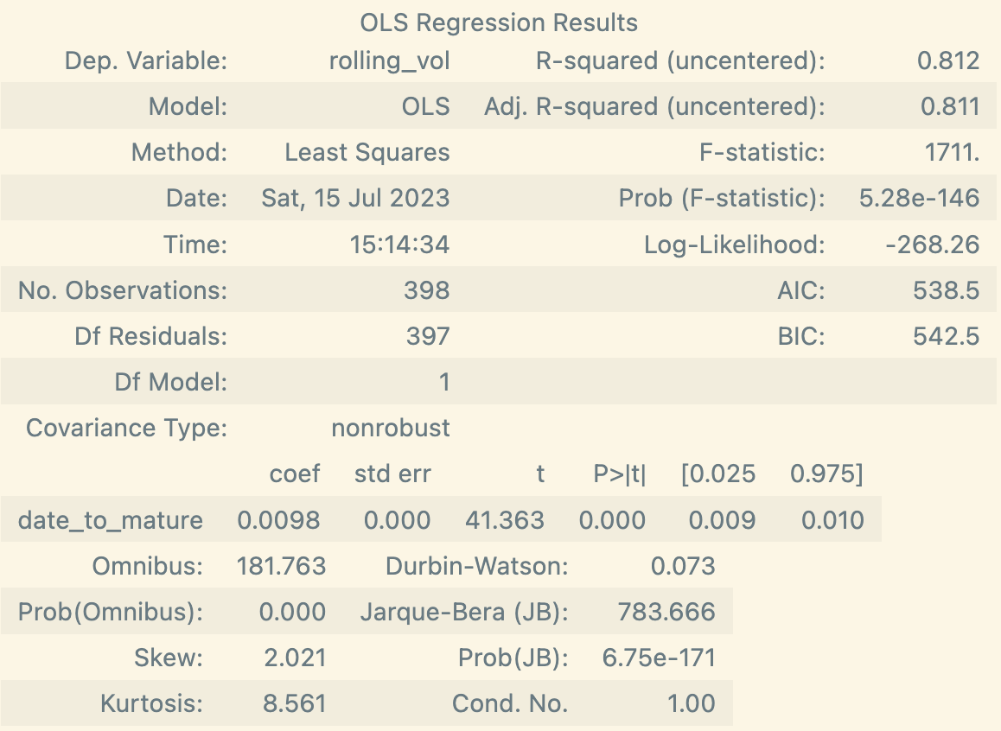
Correlation and Linear Regression
Different assumptions for future’s sigma…
Also may related to interest rates, calendar dates, … and other related factors
Regress historical volatility on future dates to expiration to obtain coefficients
We can get the coefficient and obtain a R^2 value of 0.81
Caution when estimating sigma solely based on time to maturity (t); consider additional factors and thorough analysis for accurate estimation

Slide 13
